Slide 1
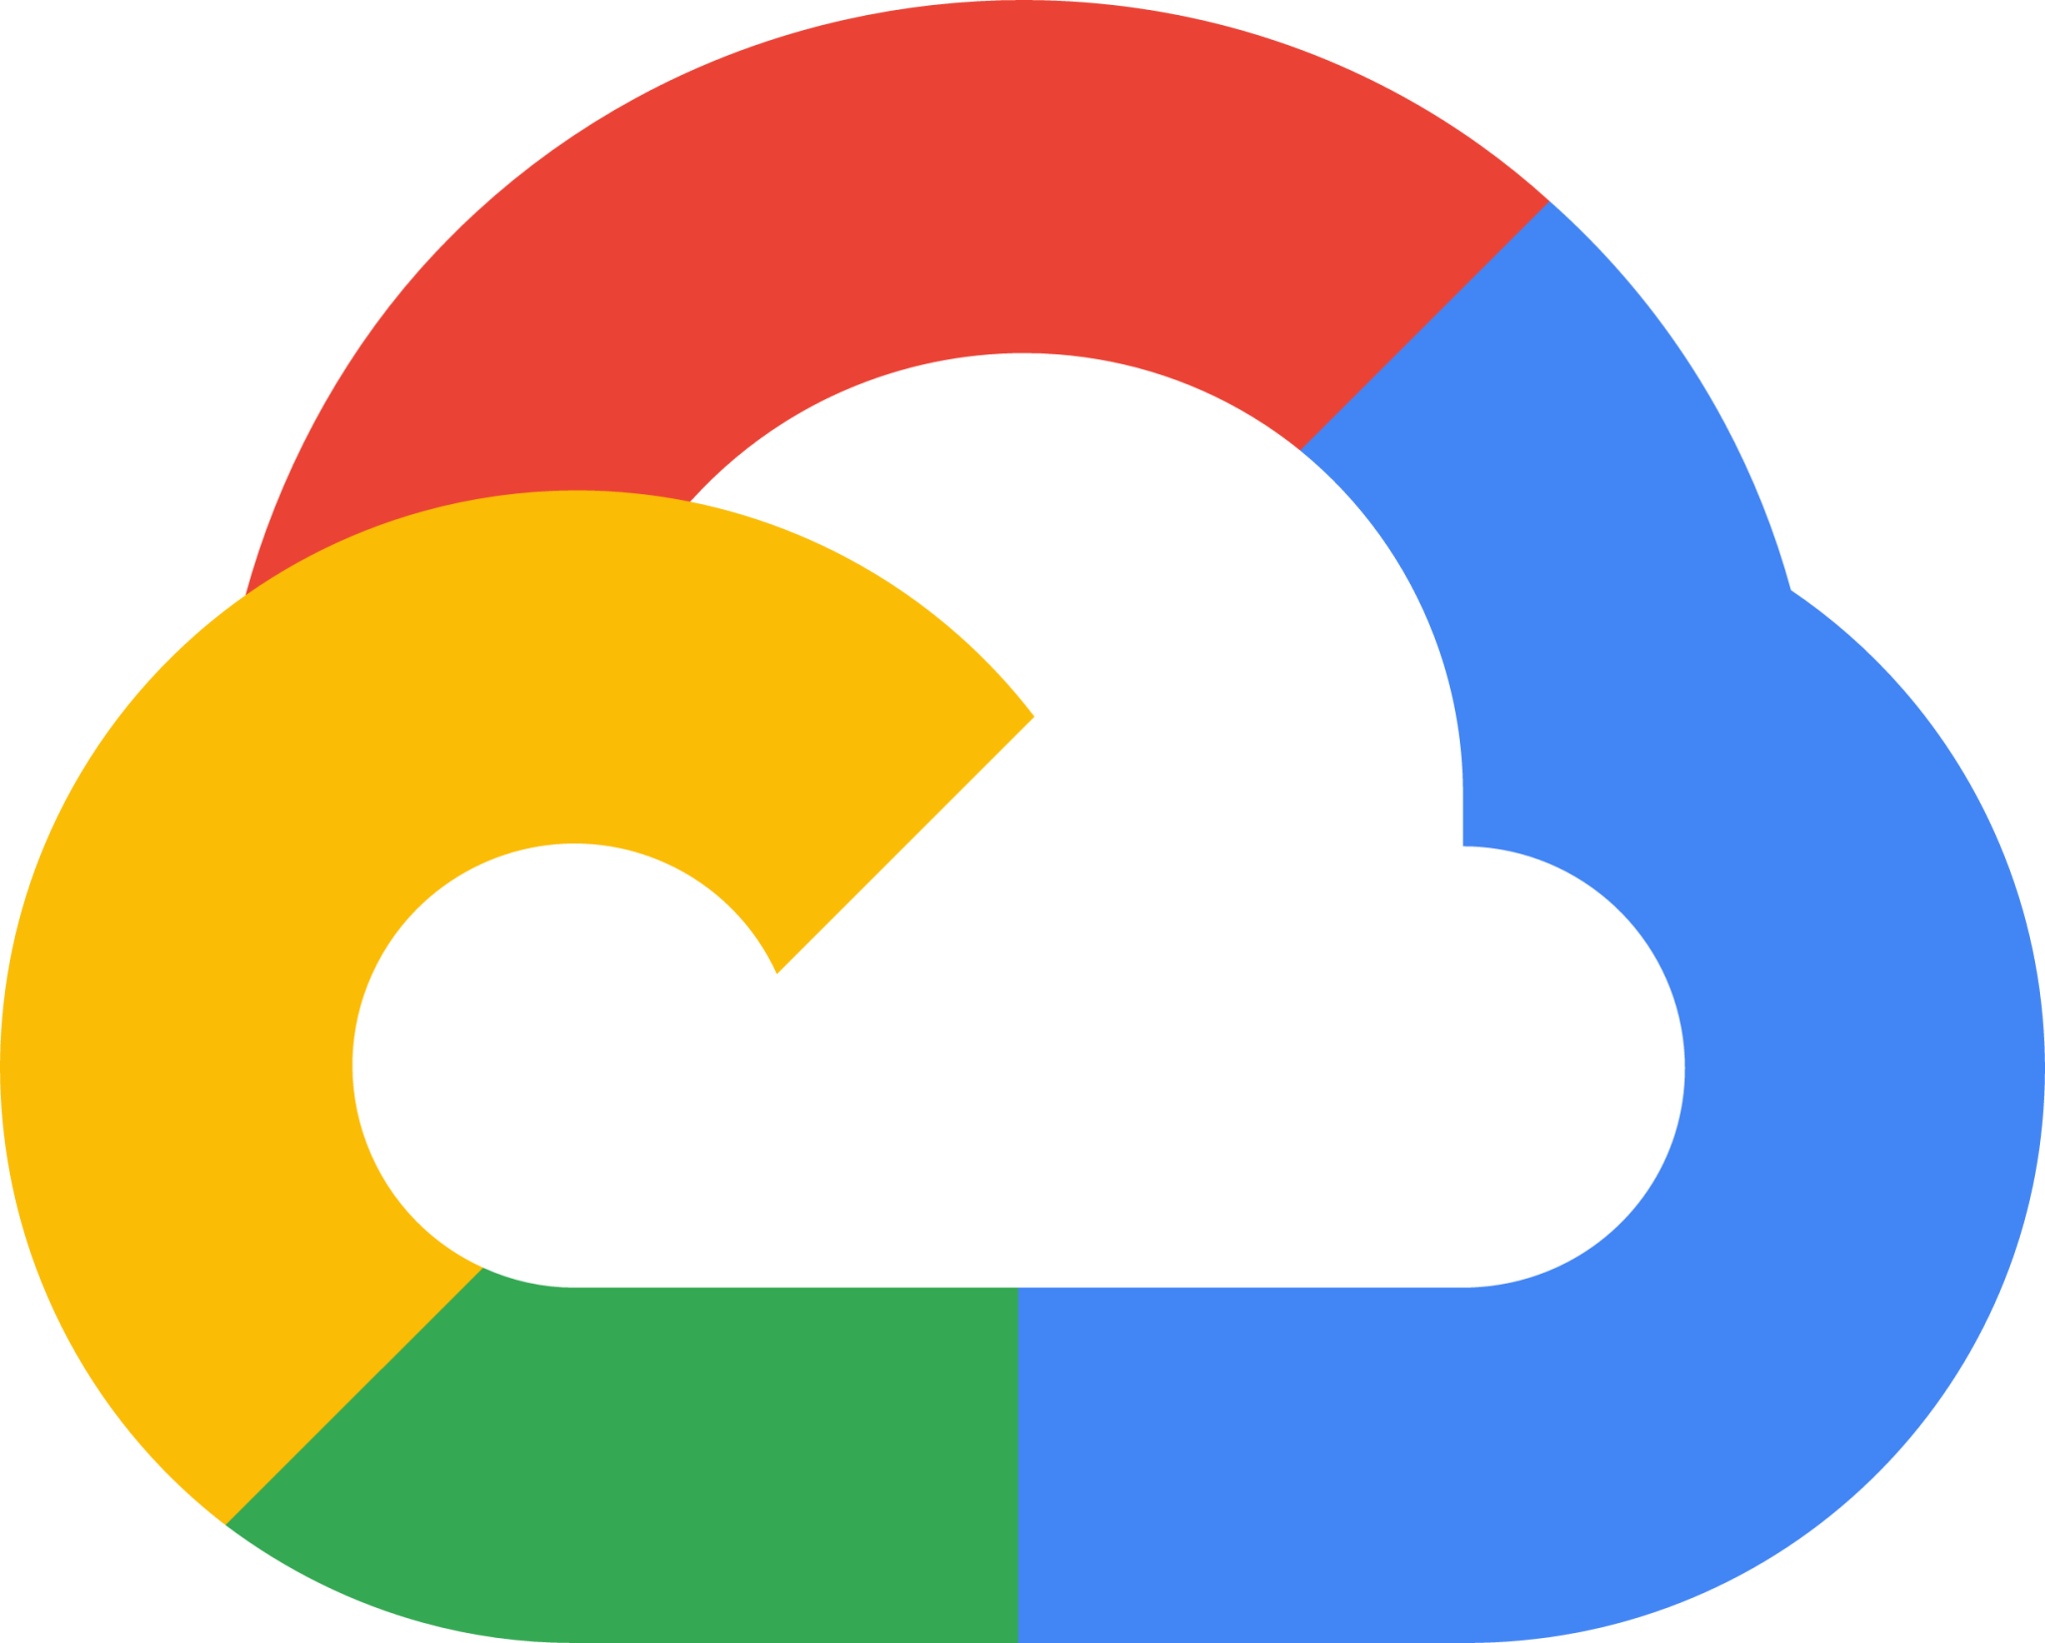
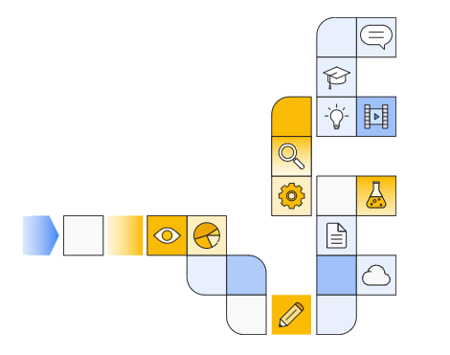
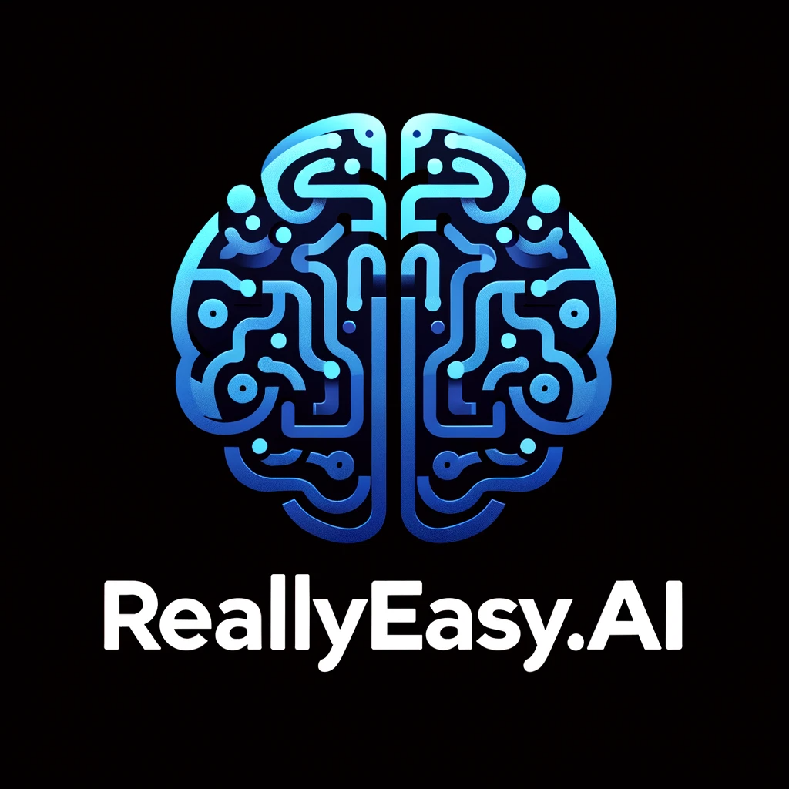
Introduction to google cloud skills boost for AI professionals

Slide 2

Setting A Goal: Certification and/or Knowledge?

Slide 3
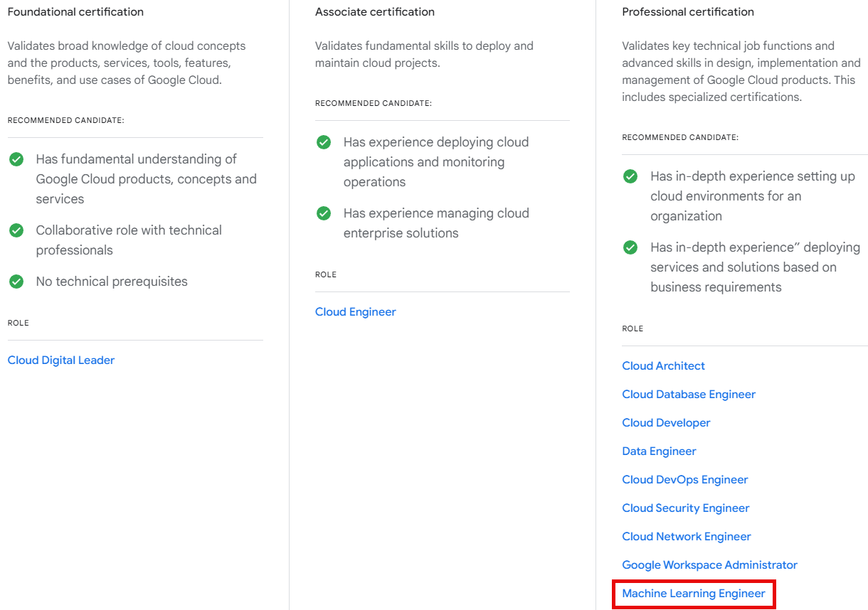
Notes:
https://cloud.google.com/learn/certification

Slide 4
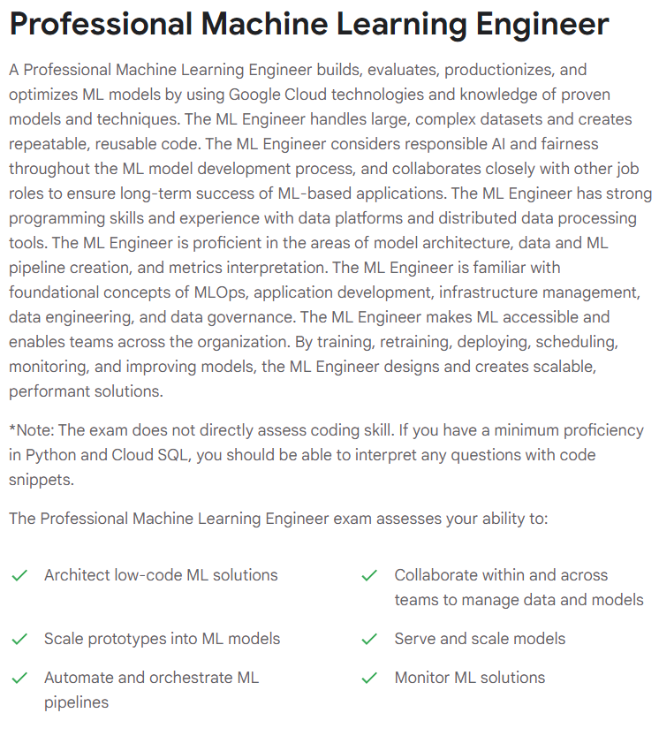
Notes:
https://cloud.google.com/learn/certification/machine-learning-engineer

Slide 5
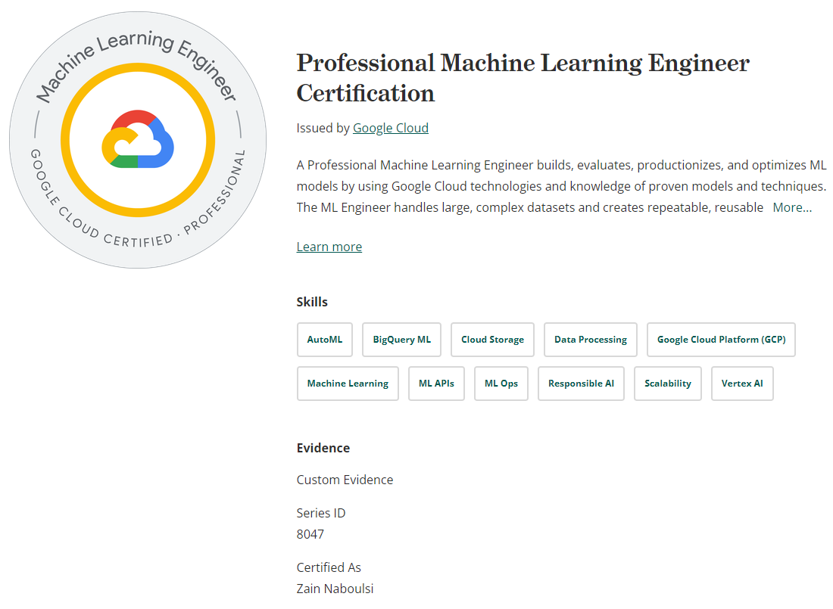

Slide 6
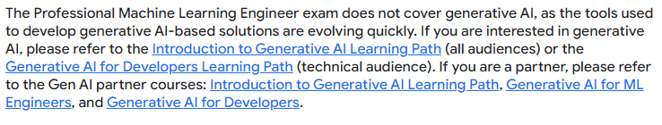

Slide 7


Slide 8

Getting Started

Slide 9
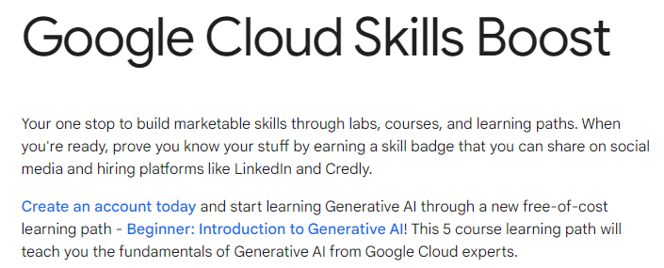
https://www.cloudskillsboost.google/
Notes:
https://www.cloudskillsboost.google/

Slide 10
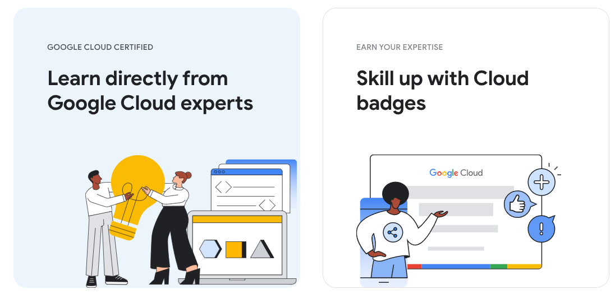

Slide 11
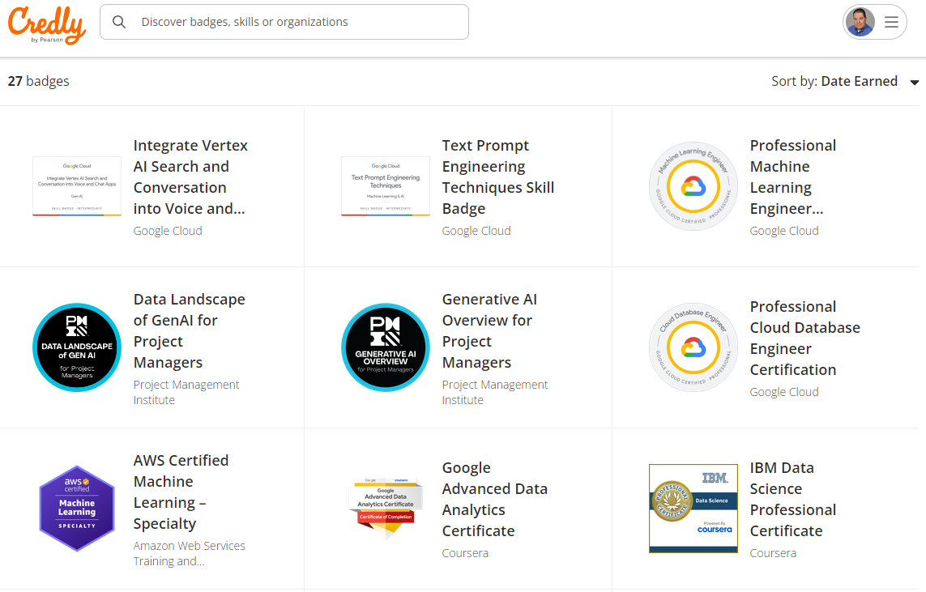
Notes:
https://www.credly.com/

Slide 12
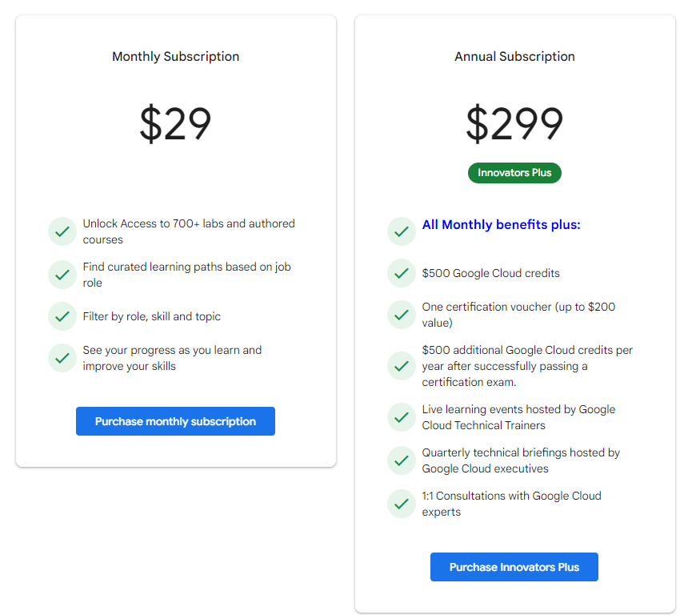
Notes:
https://www.cloudskillsboost.google/subscriptions
*Innovators Plus requires you to use a Google Account and a Developer Profile. For Customers in the EEA, the UK, and Switzerland, Innovators Plus is restricted to business or professional use.

Slide 13
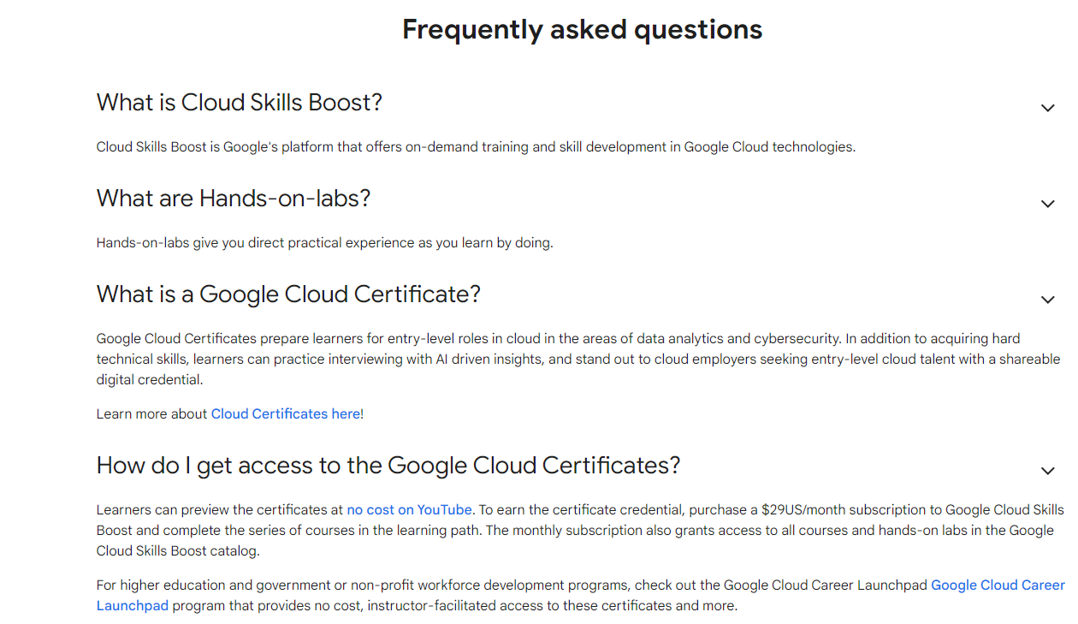

Slide 14

Learning paths

Slide 15
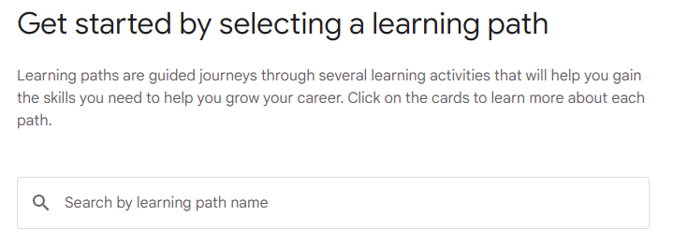
https://www.cloudskillsboost.google/paths
Notes:
https://www.cloudskillsboost.google/paths

Slide 16
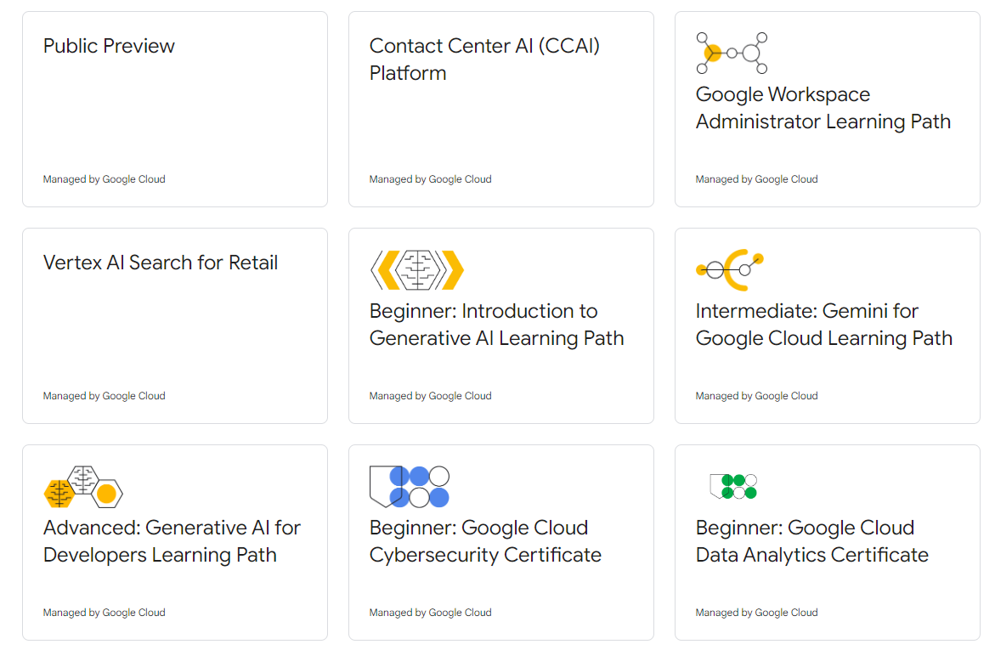

Slide 17
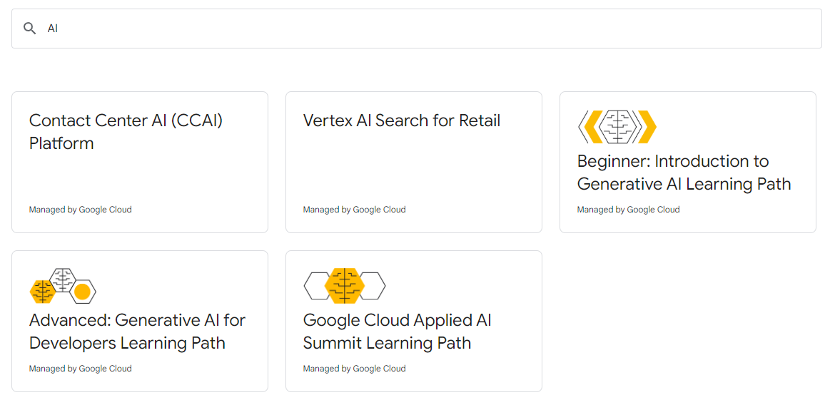
AI Paths

Slide 18
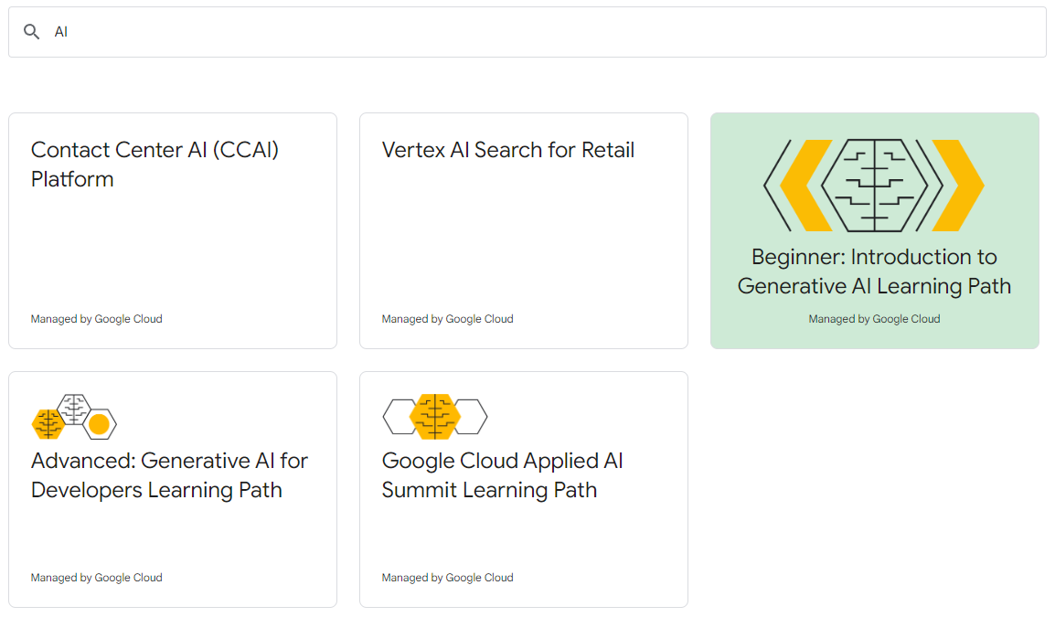
Completing an AI Path

Slide 19

Exploring courses

Slide 20
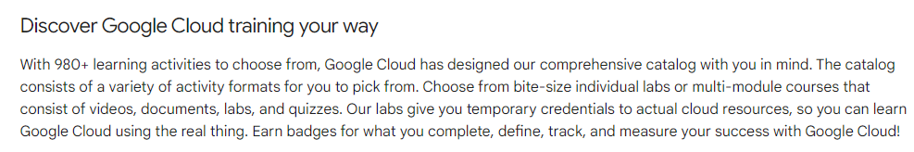
https://www.cloudskillsboost.google/catalog
Notes:
https://www.cloudskillsboost.google/catalog

Slide 21
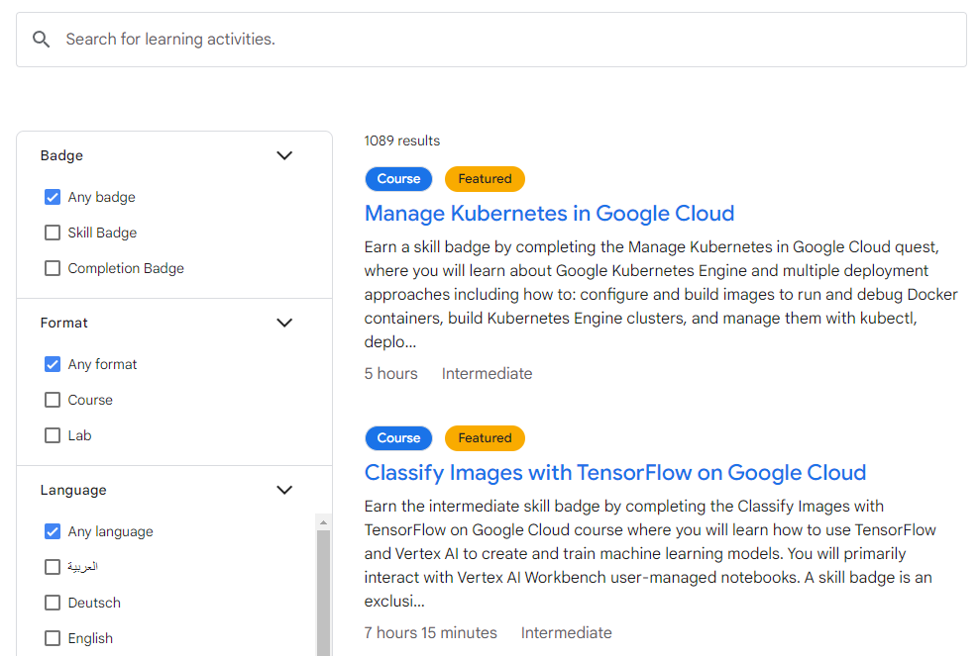

Slide 22


